Slide 1
React.JS
Lecture 30
Using Redux in React

Slide 2
Flux
Flux Framework
Dispatcher process one action at a time
Action is propagated to all stores before the views are changed (prevents cycling)
If a view needs to update something, it generates new action
Promotes one-way rendering
Action
Dispatcher
Store
View
Action

Slide 3

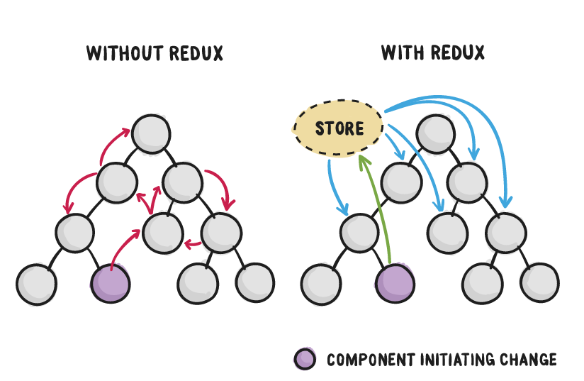
Redux
Open-source JavaScript library
Designed for managing application state
3￼

Slide 4
Definition of Redux
From the Redux website, "Redux is a predictable state container for JavaScript apps."
Predictable – state changes follow the three principles
State – the application's data, including data related to the UI itself
Container – Redux is the container which applies actions to the pure reducer functions to return a new state
Redux has been designed for JavaScript applications

Slide 5
Differences from Flux
While Redux and Flux share similar concepts and principles, there are some differences
Flux differentiates between the dispatcher and store, this is because Flux supports multiple stores
Redux limits the application to one store which means the store and dispatcher can be combined into one dispatcher-store
This dispatcher-store is created by Redux's createStore function

Slide 6
Redux
WHEN DO I NEED REDUX?
Complex data flows
Inter-component communication
Non-hierarchical data
Many actions
Same data used in multiple places
JS
jQuery
React
React + Redux
Simple
No setup
Complex
Significant setup
6￼

Slide 7
Why Redux?
Managing state in JavaScript applications is very challenging
Redux employs a predictable state container to simplify state management
Execution of an application is an initial state followed by a series of actions

Slide 8
Why Redux?
Each action reduces the state to a new predictable state, to which the application user interface transitions
A state container, known as store, contains the reduction logic implemented as pure functions as well as the last reduced (current) state

Slide 9
Three Principles of Redux
To enable state changes to be predictable, the following constraints applied to state changes
Single Source of Truth//Store
State is Read-Only//Actions to new state
Changes are made with Pure Functions//Reducer

Slide 10
Single Source of Truth
Following the pattern of Flux, all data flows through a Redux system in a unidirectional matter
All changes to the state comes from actions applied to the state, and all actions are funneled into Redux
No part of the system can ever receive data from two sources
Additionally, the state managed by Redux is the state of the whole application (with minor exceptions, such as form control entry)

Slide 11
State is Read-Only
State can never be mutated
New states are produced by applying an action to the current state (known as reduction) from which a new state object is produced
Immutable programming techniques need to be utilized

Slide 12
Changes are made with Pure Functions
Pure functions accept inputs, and using only those inputs produce a single output
The function produces no side effects
Many pure functions can be composed together to process different parts of the state tree

Slide 13
Redux
3 PRINCIPLES OF REDUX
One immutable store
Actions trigger changes
Reducers update state
13￼

Slide 14
Redux
REDUX FLOW
Action
{ type: RATE_COURSE, rating: 5 }
function appReducer(state, action) {
switch(action.type){
case RATE_COURSE:
// return new state
}
}
Store
Reducers
React
Notified via React-Redux
14￼

Slide 15
Redux
Redux Framework
Informal successor of Flux
All data are in one store (one object)
No dispatcher, actions are process by reductor(s)
Reductor is a pure function (state, action) => state
State should be never modified
Action
Reductor(s)
Store
View
Action

Slide 16
Redux
State and Reducers
Both action and state can be recorded (debugging, undo)
Action
Simple (serializable) object (no methods)
Pure function, no internal state
State
Reducer
New State
Current state in the store (immutable)
New state replaces current state in the store

Slide 17
Redux
Redux Example
const INC_ACTION = 'INC';
const reducer = (state, action) => {
const { type, counter } = action;
switch (type) {
case INC_ACTION:
return { ...state, [counter]: state[counter]+1 };
}
return state;
}
const initialState = { counter1: 0, counter2: 0 }
const store = createStore(reducer, initialState);
...
dispatch({ type: INC_ACTION, counter: 'counter1' });
Forgive the switch
Shallow copy
And the counter is modified
Dispatch the action object to the reducers
Notes:
The framework is much more complex. Reducers may be created in more elaborate way (and even combined together), middleware can be used to augment/process actions, listeners may be subscribed to detect changes in the store, …

Slide 18
Redux
State Immutability
New state is produced with every action
Simplifies snapshotting (saving/restoring)
Simplifies change detection (for visualization)
Raises issue of efficiency
Shallow copies, shared references
New objects
Modification
State
State

Slide 19
Redux
IMMUTABILITY
“to change state, return a new object”
MUTATING STATE
NOT MUTATING STATE
state = {
name: ‘Ivan’,
role: ‘developer’
}
state.role = ‘admin’;
return state;
state = {
name: ‘Ivan’,
role: ‘developer’
}
return state = {
name: ‘Ivan’,
role: ‘admin’
}
19￼

Slide 20
Redux
IMMUTABILITY
“to change state, return a new object”
SIGNATURE
Object.assign(target, ...sources)
EXAMPLE
Object.assign({}, state, { role: ‘admin’ });
Handling Immutable State
ES6
ES5
LIBRARIES
Object.assign
Spread operator
Lodash merge
Lodash extend
Object-assign
react-addons-update
Immutable.js
20￼

Slide 21
Redux Store
• Holds the current state value
• Created using createStore()
• Supplies three methods:
– dispatch(): states state update with the provided action object
– getState(): returns the current stored state value
– subscribe(): accepts a callback function that will be run every time an action is dispatched

Slide 22
Redux
REDUX STORE
“single source of truth”
const store = createStore(reducer);
store.dispatch(action)
store.subscribe(listener)
store.getState()
replaceReducer(nextReducer)
22￼

Slide 23
Redux Actions
Actions: payloads of information that send data from your application to the store
Done through store.dispatch()
Plain JS object that must have
A type property that indicates the type of action to be performed
Best supported by defining action types as String constants
Rest of the object contains the data necessary for the action (payload)

Slide 24
Action Creators
Functions that create actions
Encapsulate the process of creating the action objects
Return the action object
Resulting action object can be passed to the store through dispatch()

Slide 25
Redux
REDUX ACTION
{ type: RATE_COURSE, rating: rating }
USING ACTION CONSTANTS
export const RATE_COURSE = 'RATE_COURSE';
REDUX ACTION CREATOR
rateCourse(rating){
return { type: RATE_COURSE, rating: rating }
}
25￼

Slide 26
Actions and Reducers
Reducers should be able to take the previous state and action and return next state:
Do not mutate state
Make a copy and modify the copy before returning it
Actions typically handled through a switch statement switching on the action type
Return the previous state in the default case

Slide 27
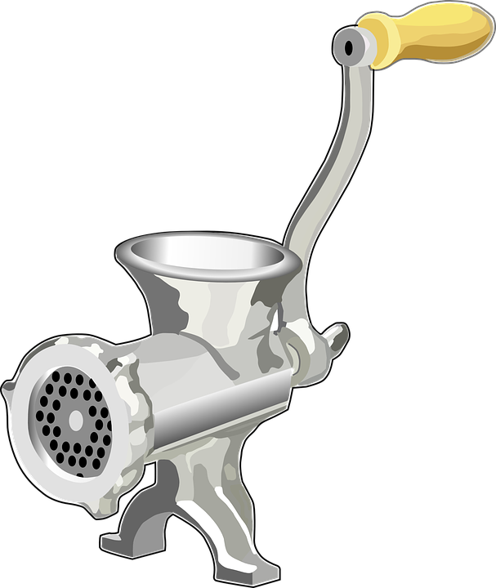
Redux
REDUX REDUCER
“state is read-only”
function myReducer(state, action){
switch (action.type){
case INCREMENT_COUNTER:
// return new state based on action passed
}
}
action
state
new state
27￼

Slide 28
Redux
REDUX REDUCER
“changes are made with pure functions”
// Pure functions
function square(x) {
return x * x;
}
function squareAll(items) {
return items.map(square);
}
28￼

Slide 29
Redux
REDUX REDUCER
“changes are made with pure functions”
// Impure functions
function square(x) {
updateXInDatabase(x);
return x * x;
}
function squareAll(items) {
for (let i = 0; i < items.length; i++) {
items[i] = square(items[i]);
}
}
29￼

Slide 30
Splitting and Combining Reducers
Depending on the state shape, fields and updates to them could be decoupled:
Split the reducer into simpler reducer functions that operate on only some of the fields
Manages parts/slices of the global state
Combine the simpler functions to generate the overall state

Slide 31

Redux
ALL REDUCERS ARE CALLED ON EACH DISPATCH
{ type: DELETE_COURSE, 1 }
loadStatus
authors
courses
New State
31￼

Slide 32
React-Redux
React-Redux Connector
Initial inputs of components are taken from Redux
Selector(s) pick only the part of the state necessary
Page
Selector(s)
Component
Redux store
Component
Virtual DOM

Slide 33
React with Redux
Use the react-redux package for bindings between React and Redux
– connect(): generates a wrapper “container” component that subscribes to the store
– Surround your App root with <Provider>
• Takes the store as an attribute
• Makes store accessible to all connected components

Slide 34
React with Redux
The connect() function takes two optional arguments:
– mapStateToProps(): called every time store state changes. Returns an object full of data with each field being a prop for the wrapped component
– mapDispatchToProps(): receives the dispatch() method and should return an object full of functions that use dispatch()

Slide 35
Implementation Steps

Slide 36
Example
import { createStore } from 'redux’
function counter(state = 0, action) {
switch (action.type) {
case 'INCREMENT':
return state + 1
case 'DECREMENT':
return state - 1
default:
return state
} }
let store = createStore(counter)
store.subscribe(() => console.log(store.getState()))
store.dispatch({ type: 'INCREMENT' })
store.dispatch({ type: 'INCREMENT' })
store.dispatch({ type: 'DECREMENT' })

Slide 37
Steps
install redux and react-redux
create a reducer.
create a store passing in this reducer.
wrap your app in a Provider passing in the store.
create a mapStateToProps function
create a mapDispatchToProps function (if you wish to update the state)
connect your app to the redux store

Slide 38
Step 1:Installation
npm install redux/yarn add redux
You need these two modules along with Redux
npm install react-redux
npm install --save-dev redux-devtools

Slide 39
Step 2: Creating Reducer
const counter = (state = 0, action) => {
switch(action.type) {
case 'INCREMENT':
return state = state + 1;
case 'DECREMENT':
return state = state -1;
default:
return state;
}
};
You can create it in same file as store or independently

Slide 40
Step3 & 4: Creating Store
import { createStore } from 'redux’;
import { Provider } from 'react-redux'
const store = createStore(counter);
render( <Provider store={store}> <App /> </Provider>, document.getElementById(‘root’) );

Slide 41
Combined Code till 4th step
import React from 'react'
import { render } from 'react-dom'
import { Provider } from 'react-redux'
import { createStore } from 'redux'
import App from './App.js'
const counter = (state = 0, action) => {
switch(action.type) {
case 'INCREMENT':
return state = state + 1;
case 'DECREMENT':
return state = state - 1;
default:
return state;
}
};
const store = createStore(counter);
render(
<Provider store={store}>
<App />
</Provider>,
document.getElementById('root')
);

Slide 42
Step 5 & 6 & 7: In component
import React from 'react';
import { connect} from 'react-redux'
const App = (props) => {
return(
<div>
<p>{props.count}</p>
<button onClick={props.increment}>+</button>
<button onClick={props.decrement}>-</button>
</div>
);
};
function mapStateToProps(state) {
return {
count: state
};
}

Slide 43
Step 5 & 6 & 7: In component
function mapDispatchToProps(dispatch) {
return {
increment: () => dispatch({type: 'INCREMENT'}),
decrement: () => dispatch({type: 'DECREMENT'})
};
}
export default connect(mapStateToProps, mapDispatchToProps)(App);

Slide 44
Redux Middleware:Thunk
Provides the capability to run code after an action is dispatched, but before it reaches the reducer
Third-party extension point
e.g., logging, async API calls
Middleware:
Forms pipeline that wraps around the dispatch()
Pass actions onward
Restart the dispatch pipeline
Access the store state

Slide 45
Thunk
In programming, a thunk is a subroutine used
to inject an additional calculation in another subroutine
Delay a calculation until its result is needed,
Insert operations at the beginning or end of the other subroutine

Slide 46
Redux Thunk
Middleware that allows you to write action creators that return a function instead of an action
Can be used to delay the dispatch of an action, or
Dispatch only if a certain condition is met
Inner function receives the dispatch() and getState() store methods
npm install --save redux-thunk

Slide 47
Adding thunk to store
import { createStore, applyMiddleware } from 'redux';
import thunk from 'redux-thunk';
import rootReducer from './reducers/index';
const store = createStore(
rootReducer,
applyMiddleware(thunk)
);
Complete Example at https://daveceddia.com/where-fetch-data-redux/

Slide 48
React-Redux-Form
npm install react-redux-form –save
We will take an example now
We Will also see an example of Localform

Slide 49
Example
import { connect } from 'react-redux';
import { actions } from 'react-redux-form';
// external user data to load
const data = { /* ... */ };
const InitializeFromStateForm = (props) => {
const { dispatch } = this.props;
return (
<form>
<button type="button" onClick={() => dispatch(actions.load('user', data))}>
Load Account
</button>
{/* ... */}
</form>
);
}
export default connect(null)(InitializeFromStateForm);

Slide 50
LocalForm/Using Redux without setting up store
import React from 'react';
import { LocalForm, Control } from 'react-redux-form';
export default class MyApp extends React.Component {
handleChange(values) { ... }
handleUpdate(form) { ... }
handleSubmit(values) { ... }
render() {
return (
<LocalForm
onUpdate={(form) => this.handleUpdate(form)}
onChange={(values) => this.handleChange(values)}
onSubmit={(values) => this.handleSubmit(values)}
>
<Control.text model=".username" />
<Control.text model=".password" />
</LocalForm>
);
}}

